Slide 1


Agoda:
Optimizing Urgency Messaging to Boost Bookings.
Analyze price trends and implement urgency messaging to increase booking conversion rates.
📌 Key Goal: Identify price movement patterns and booking behavior to create data-driven urgency messaging strategies.

Slide 2

 | Understanding Price Movement Trends
 | Identifying Key Factors Influencing Price Changes
 | External Factors Affecting Price Trends
 | Delay Bookings leading to missed Revenue Opportunities
Business Challenge :
02

Slide 3
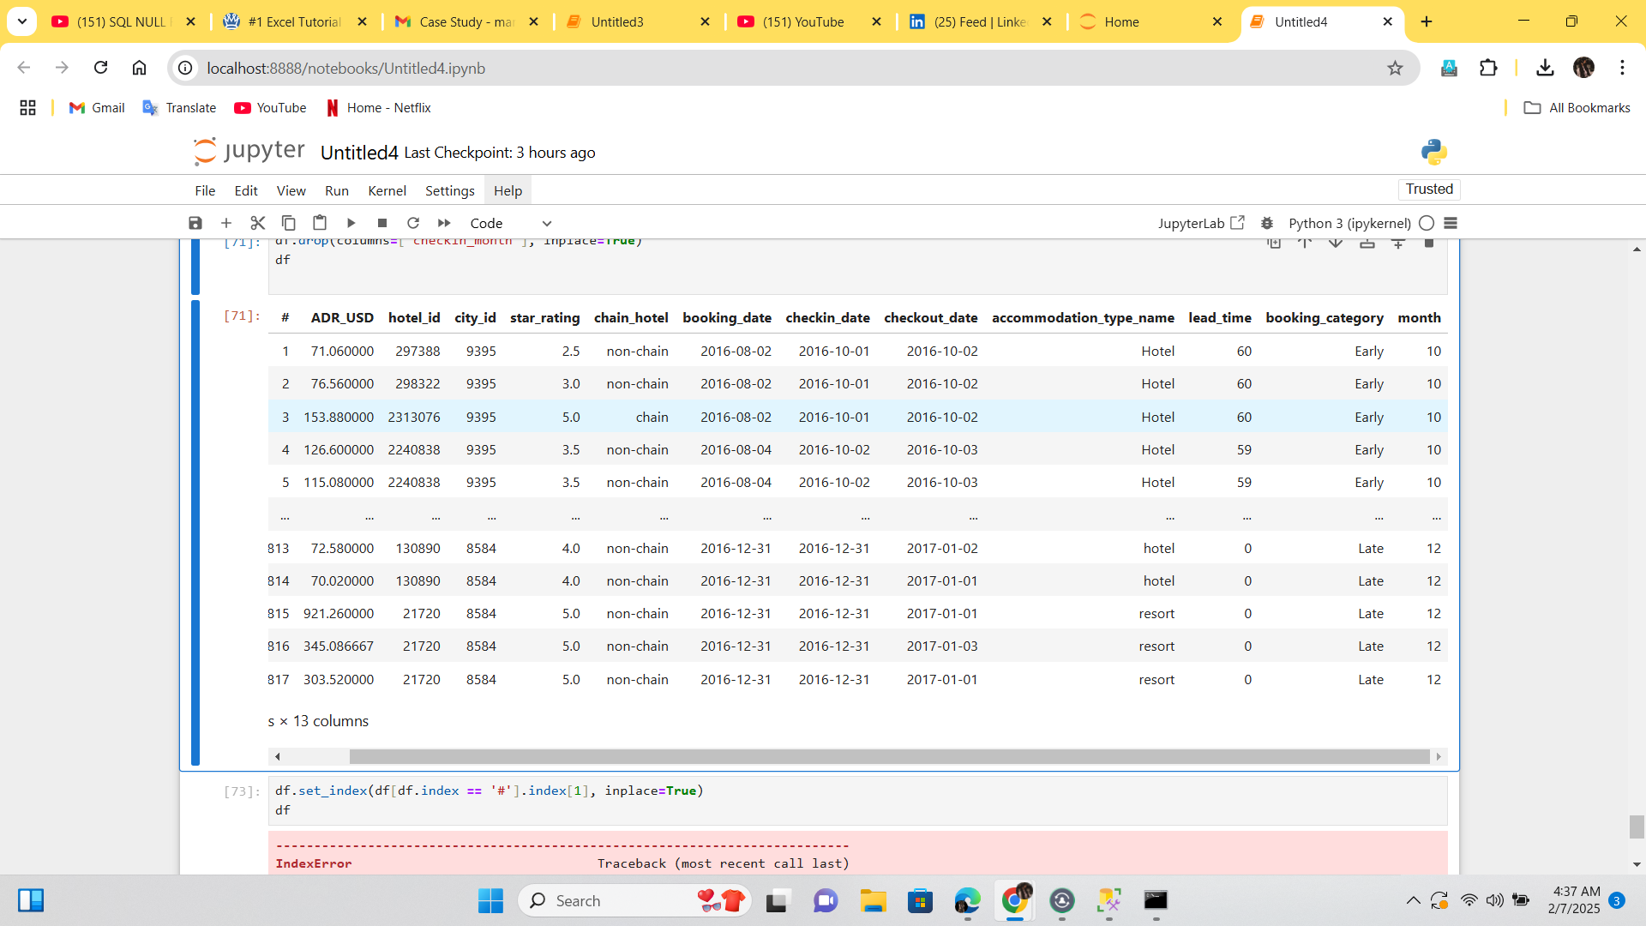

F
inal Data after Cleaning
Handled Null & Missing Values
Performed Feature Engineering
Merged Sheets & Columns
49064 rows x 13 columns

Slide 4
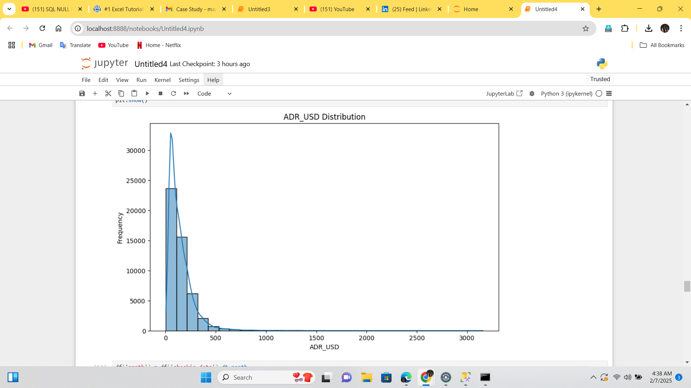
Price Distribution of Bookings
Assumptions:
The majority of bookings fall within the lower price range, with a few instances of higher-priced bookings.
Suggestion:
To target high-price range customers additional value/benefits or dynamic pricing strategy can be introduced!
Acc to data: Almost 23k customers booked in the range of 10-100 USD

Slide 5

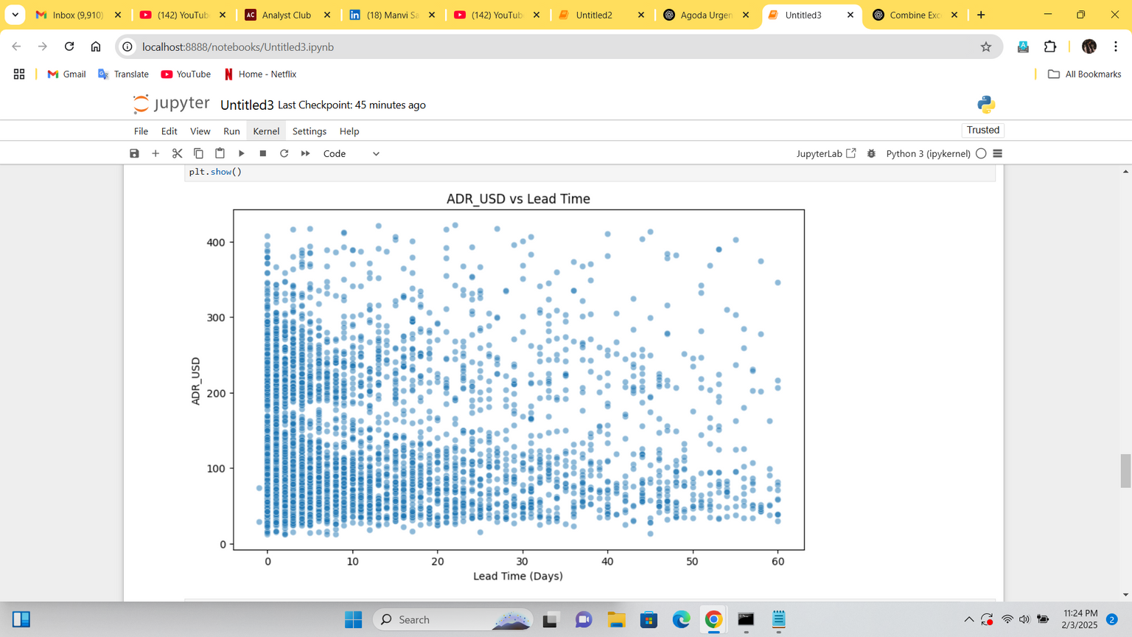
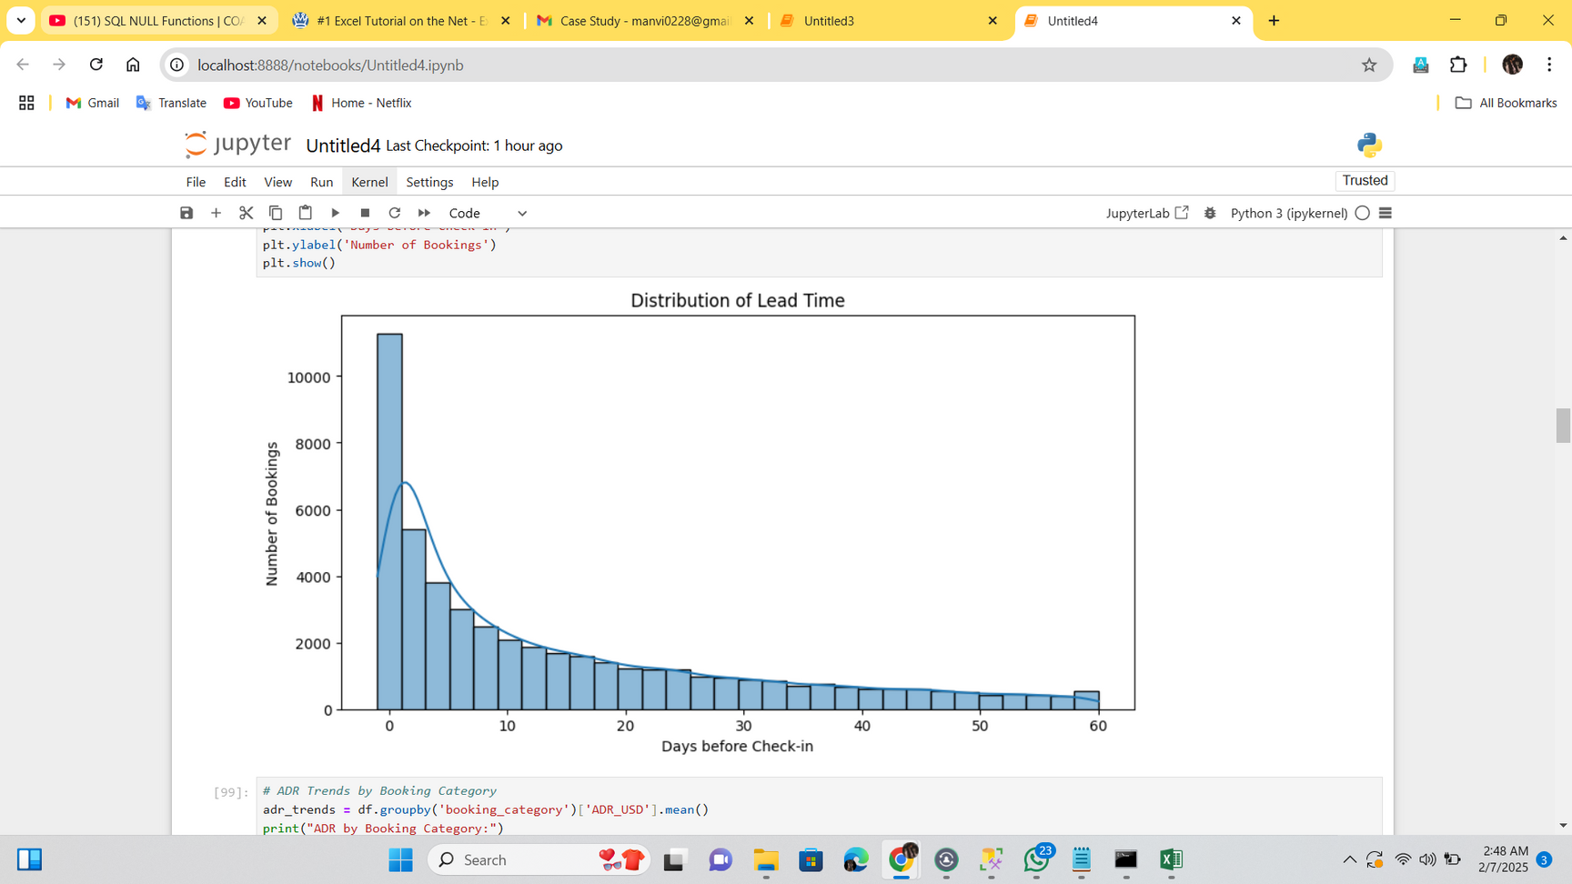
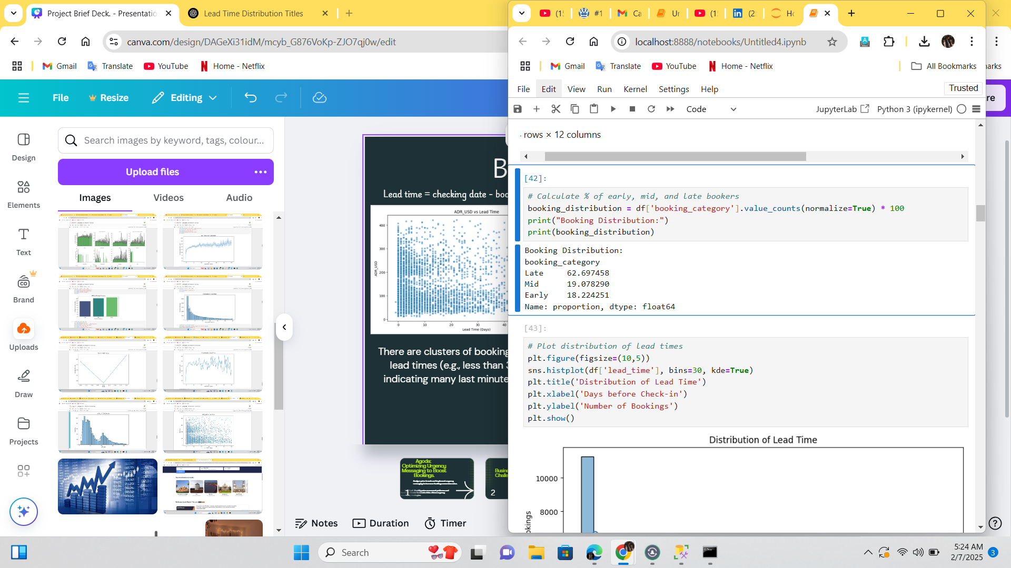
Booking Pattern by Lead time
Urgency message for shorter lead times can be more effective.
Lead time = checking date - booking date
Almost 62%, 19% and 18% customers are late. mid and early bookers respectively.
There are clusters of bookings at shorter lead times (e.g., less than 30 days), indicating many last minute bookings.
Acc to plot more than 10,000 users book in the last 10-15 days range.

Slide 6
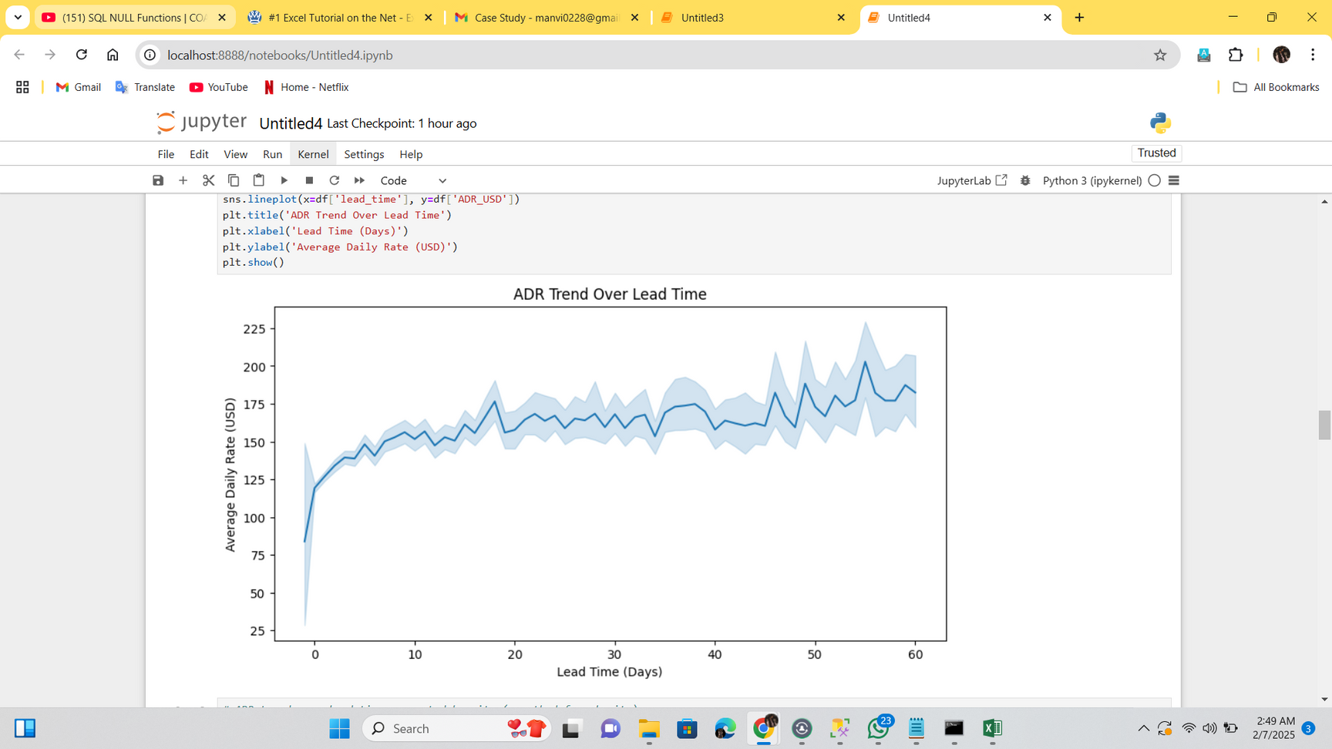
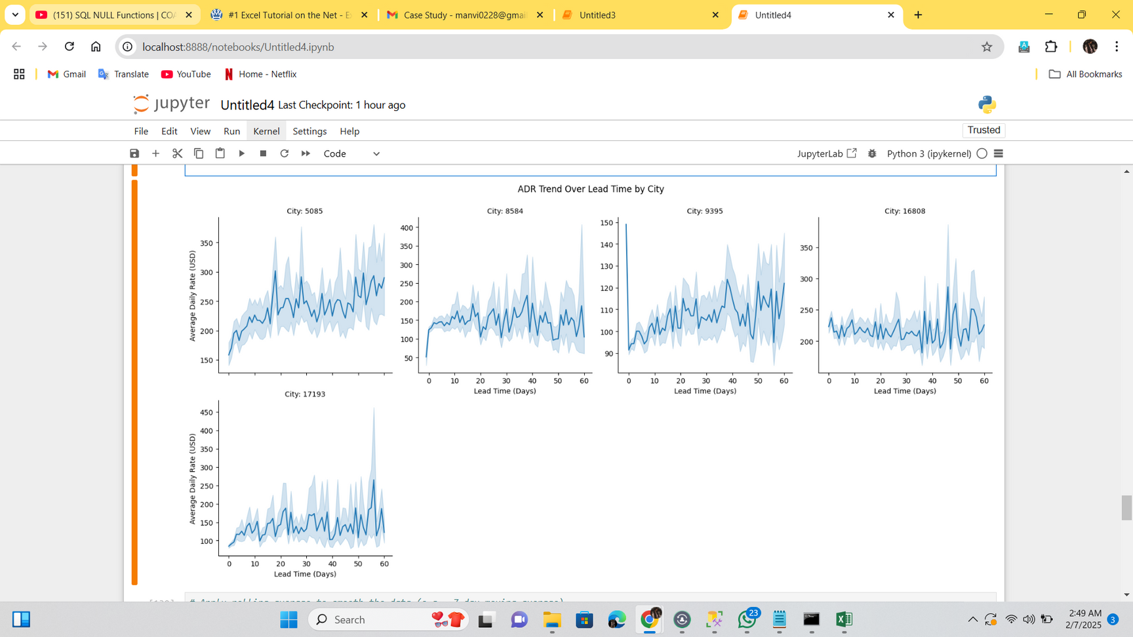
Understanding ADR Behavior as per Lead Time
This plot is to understand what factors actually affect price movements.
This plot examines whether prices naturally increase as the check-in date approaches. However, the data reveals that ADR actually drops for last-minute bookers and remains stable for mid and early bookers. This indicates that there is no significant price fluctuation over time,.
City A & City D is expensive comparative to CITY B, C & E.
Last minute bookings are less costly comparative to early bookings.

Slide 7
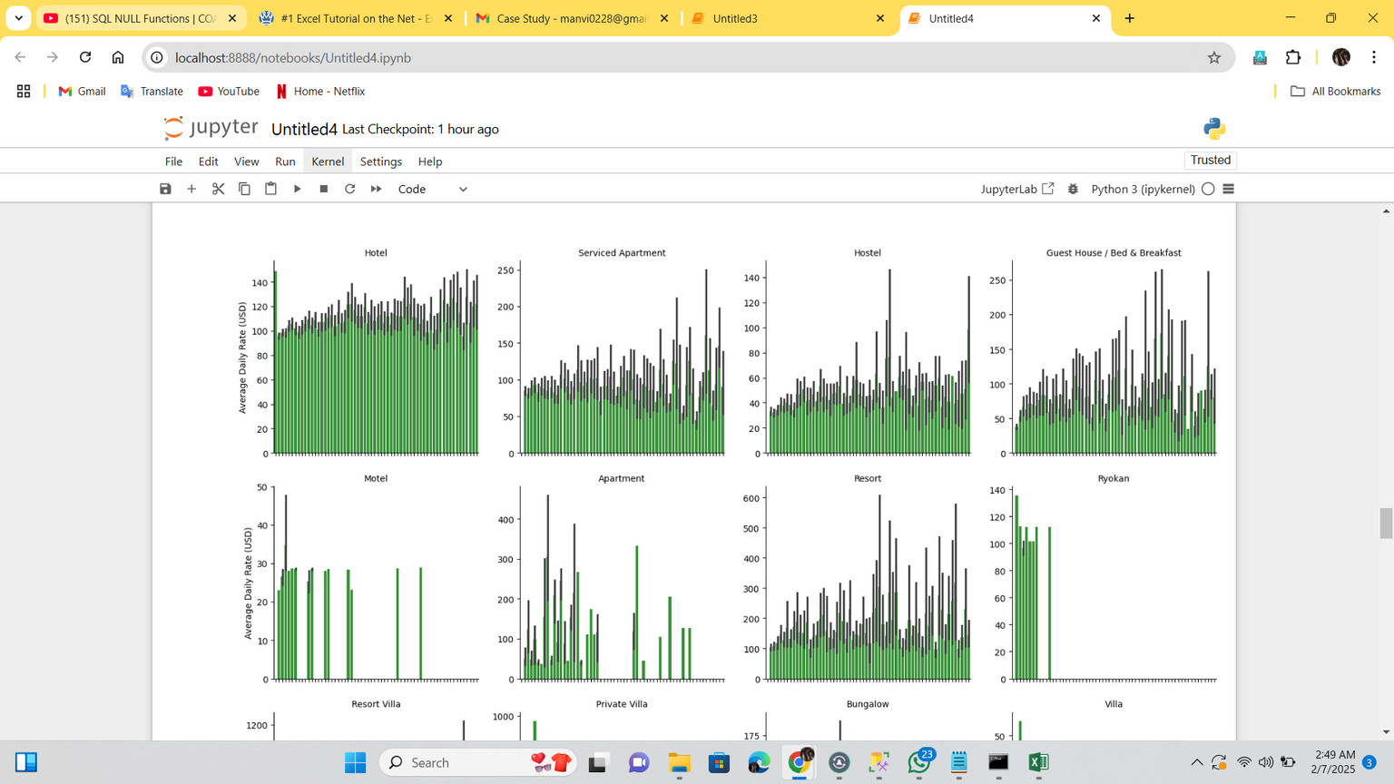
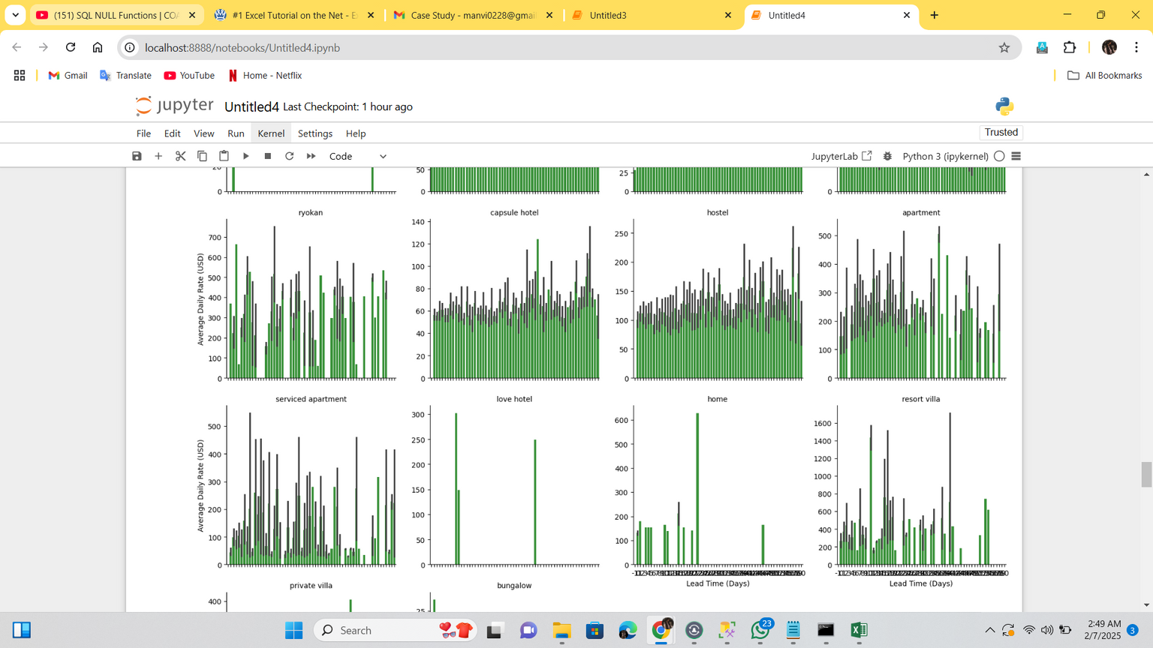
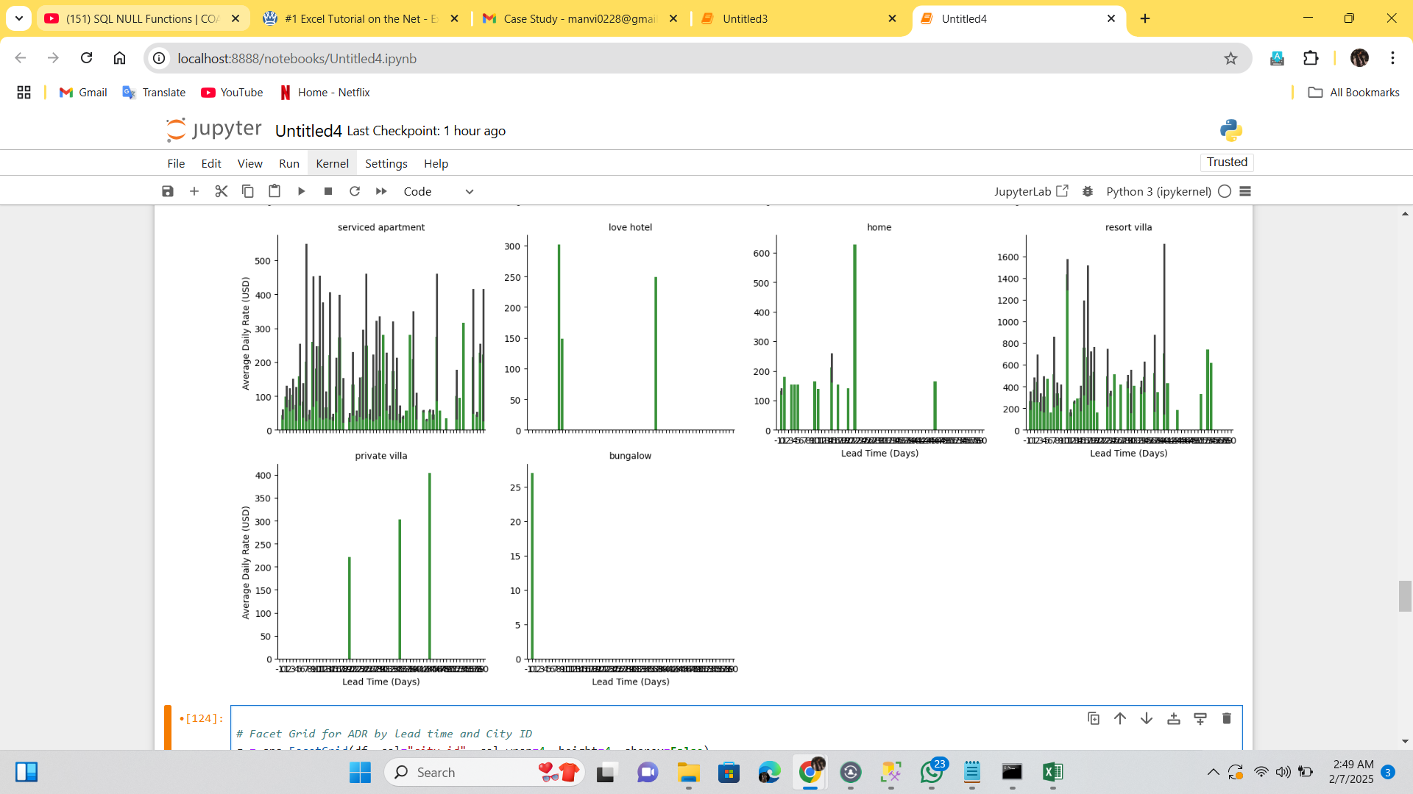
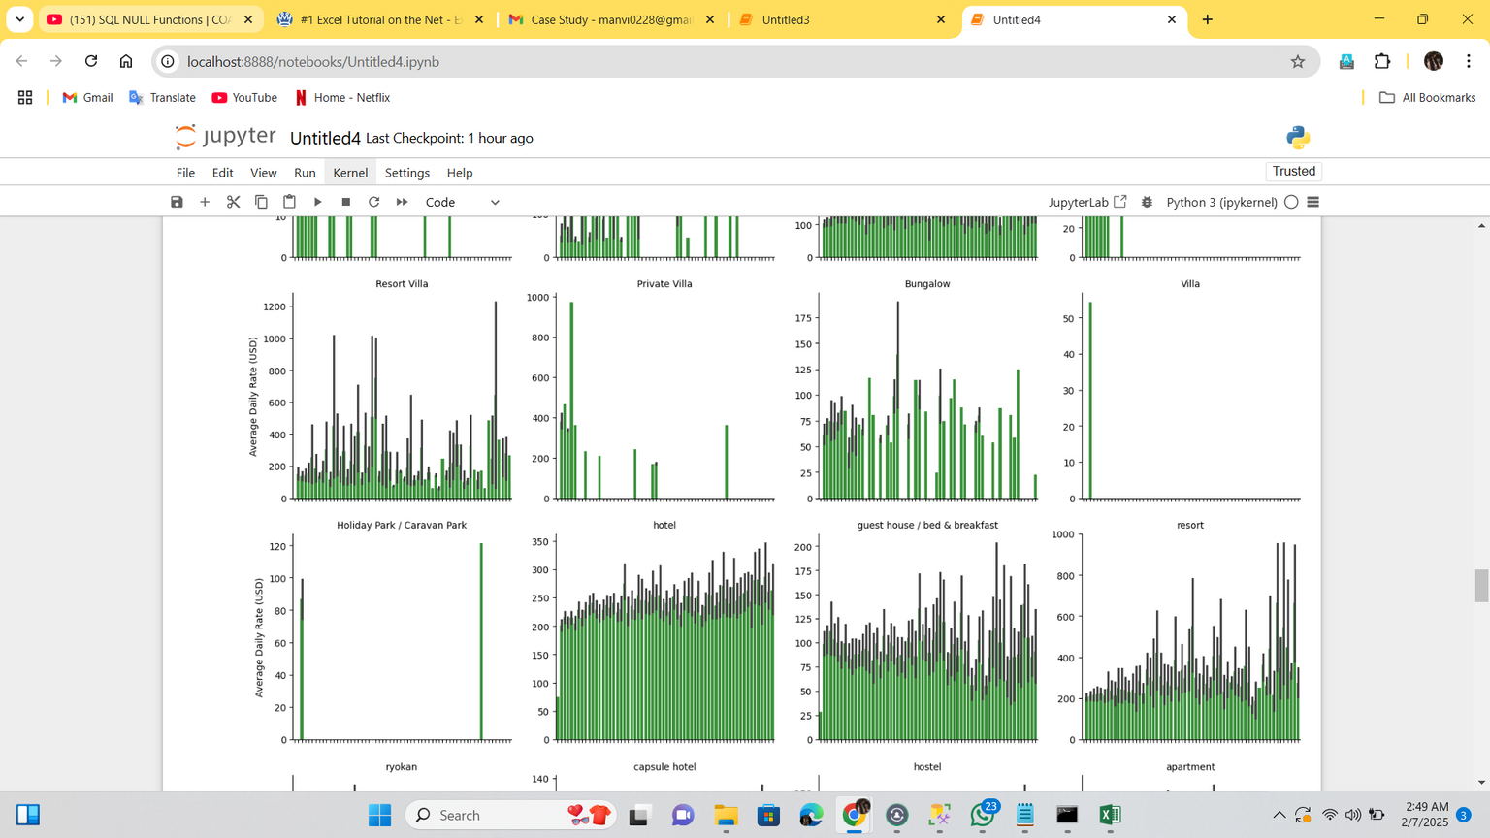
ADR Trend over Accomodation type
Hostel, Hotel, Serviced appartment, Guest hoouse, Resorts have more bookings comparative to other accomodation type.

Slide 8
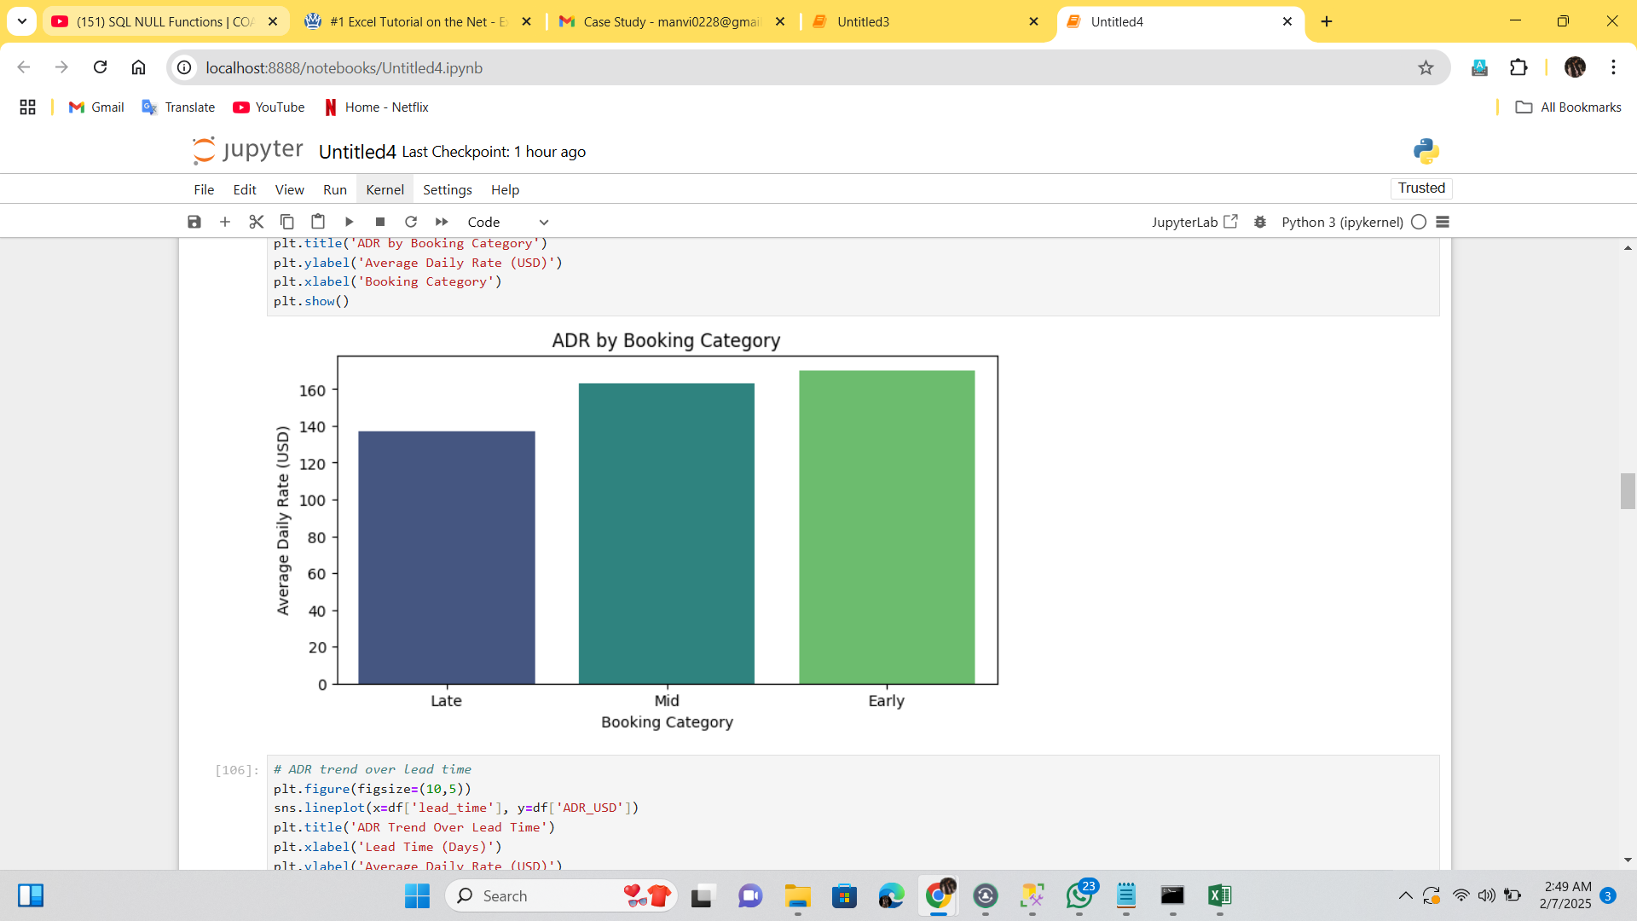
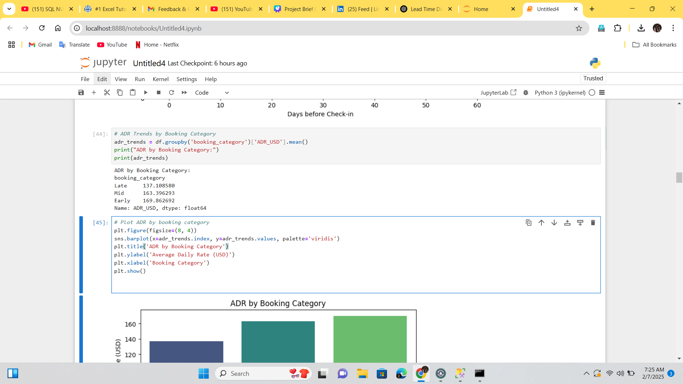
ADR Trends: Late vs. Mid vs. Early Bookers
"Discount-Based Urgency Messages May Perform Better Here.”
Assumptions:
Acc to data the ADR is lower for late bookers, hotels may be offering discounts to fill empty rooms. Late bookers are paying less comparative to early bookers which suggest that the pricing strategy could involve higher rates for early bookers, as they may prioritize securing their booking in advance.On an average 137% ADR IN USD is paid by late bookers, 163 by mid and 169 by early.
This plot examines how pricing differs for Early (30+ days), Mid (15-29 days), and Late (0-14 days) bookers.

Slide 9
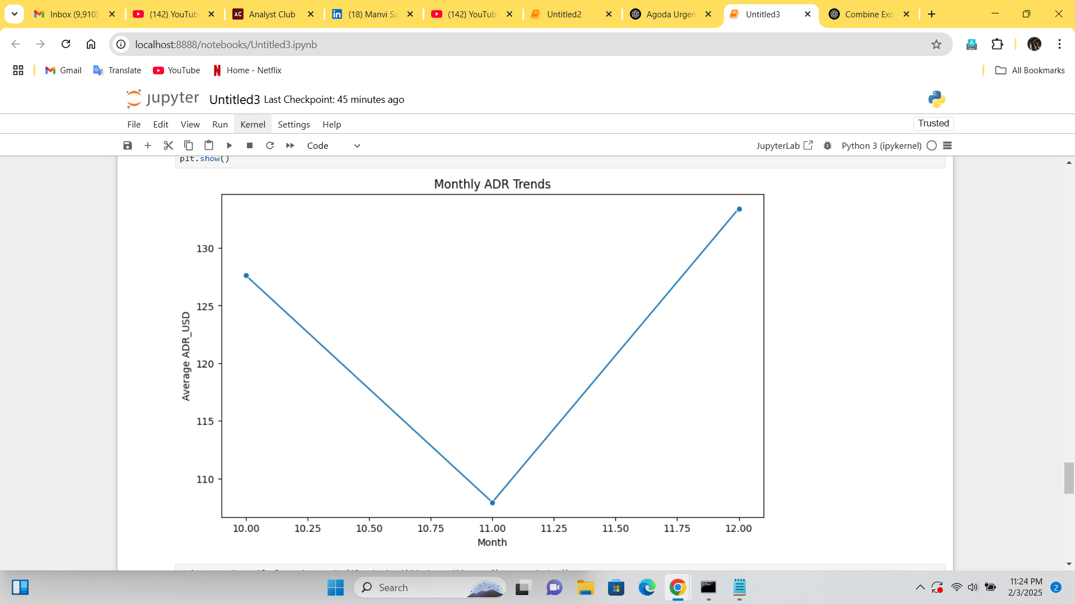
Seasonality Variations in ADR
Assumptions:
"ADR fluctuates, showing noticeable drops in certain months, indicating seasonality—higher ADR in peak months and lower ADR in low-demand periods."
Suggestion:
Consider seasonal promotions based on monthly ADR trends, targeting months with lower ADR (e.g., November, December).
Acc to data: Nov is low-demand month comparative to Oct and Dec months.

Slide 10

Recommendations:
Insights from Data:
1. Seasonal promotions can enhance conversion rates.
2. Urgency messages should be more targeted toward shorter lead times.
3. Discounts should be tested on properties with lower bookings (as seen in the accommodation type analysis).
Additional Strategies to Consider:
1. Personalized messaging based on customer behavior can drive engagement.
2. Recommending similar properties based on past booking data may improve conversions.
Validation Through A/B Testing:
*Variant A (Control Group): No urgency message.
*Variant B (Test Group): Display urgency messages.
*Success Metrics: Conversion rate uplift, reduced time-to-booking, and increased revenue per booking.
Other Options:
Customer Feedback
2. Survey Insights

Slide 11

Urgency Message Ideas!
📌
Urgency Messages should be backed by real data to create transparency and again users trust.
Discount-Driven Urgency Message -
Exclusive Limited-Time Offer: Save 20% if you book now!
Hurry! Special discount ends in the next 2 hours!
Only 2 rooms left at this price! Book now!
High demand! 5 bookings made in the last hour!
Trending property! 10 people are viewing this right now
Only a few rooms left for your travel dates! Don't miss out.
Flight booked? Now lock in your stay before last-minute price hikes!
Exclusive Winter Deal: Save 20% if you book by tomorrow!
You may also like [similar/-suggestions]!
Prices are increasing! Book within the next 30 minutes to lock this rate!
Top-rated property! Book now to experience premium comfort.
Scarcity-Based Urgency Messages -
Last-Minute Booking Messages-
Seasonal-Deal Urgency Messages-
Additional-
04

Slide 12
THANK YOU!!

